Slide 1


Slide 2
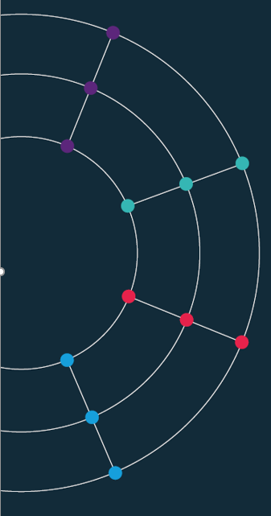
Week 9. Scraping
Economics Observatory, SPP
Finn McEvoy | Data Researcher
Josh Hellings | Data Researcher

Slide 3
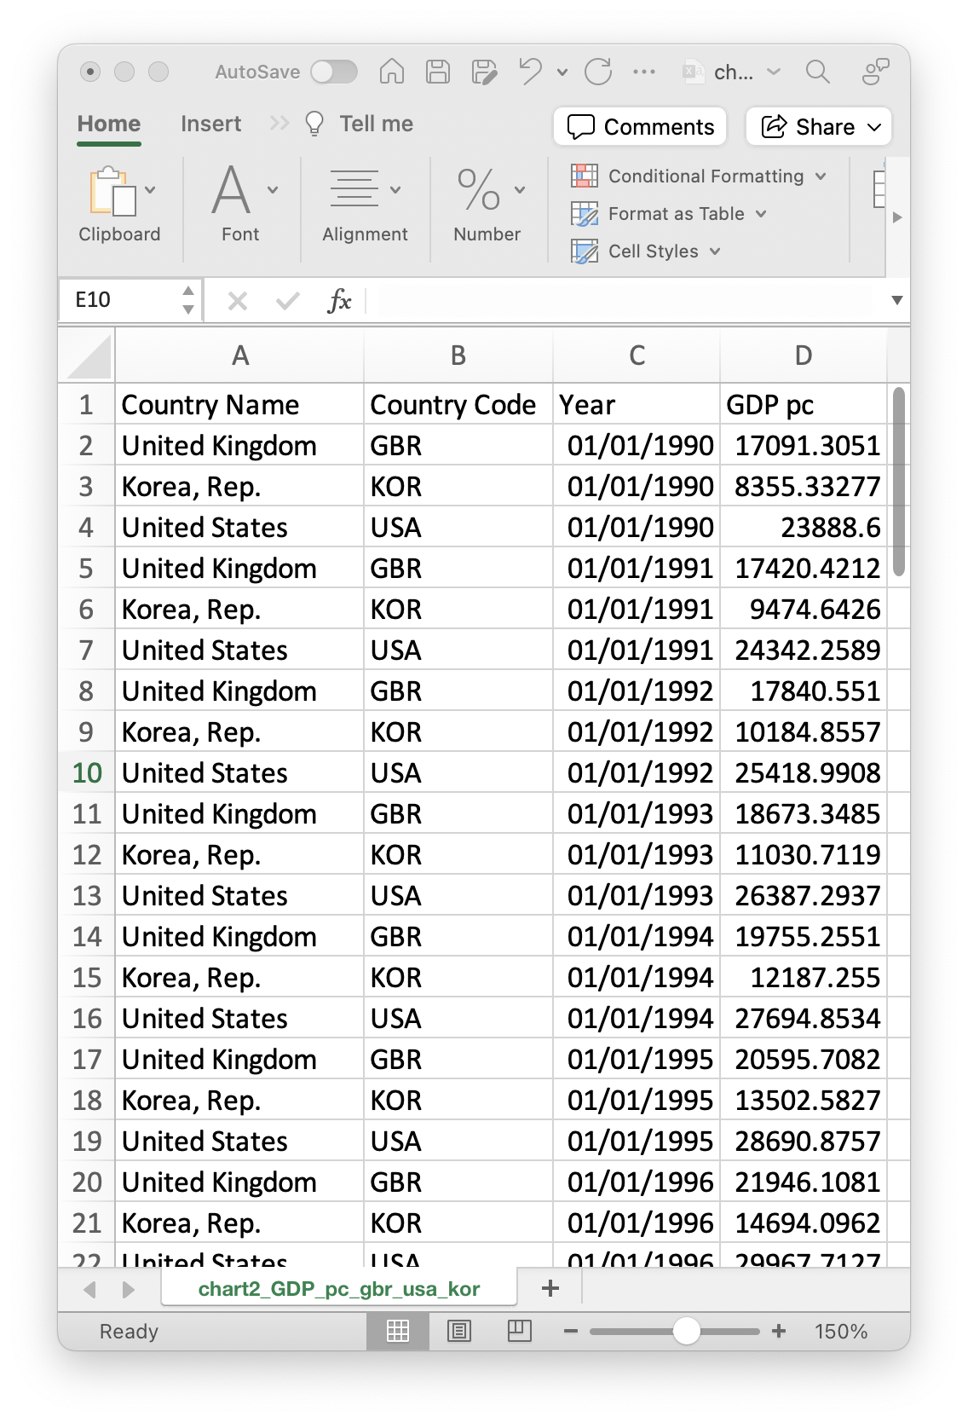
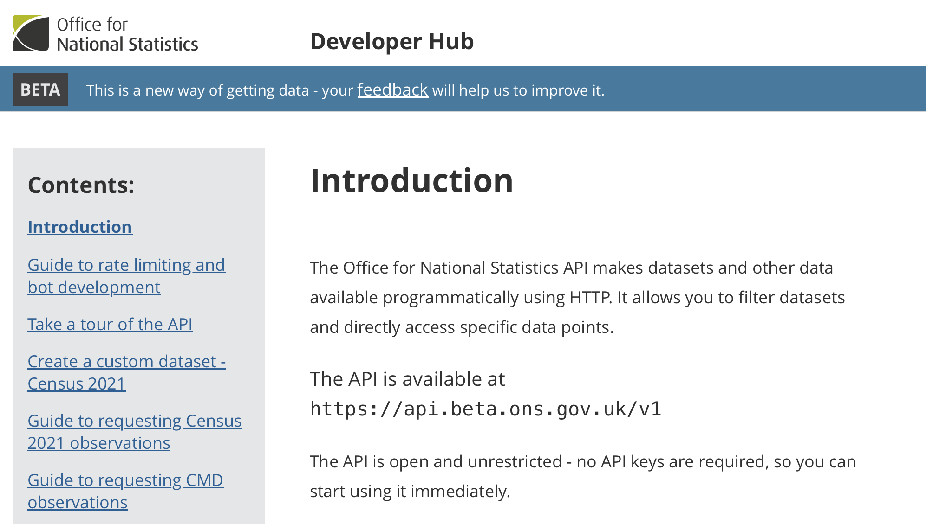
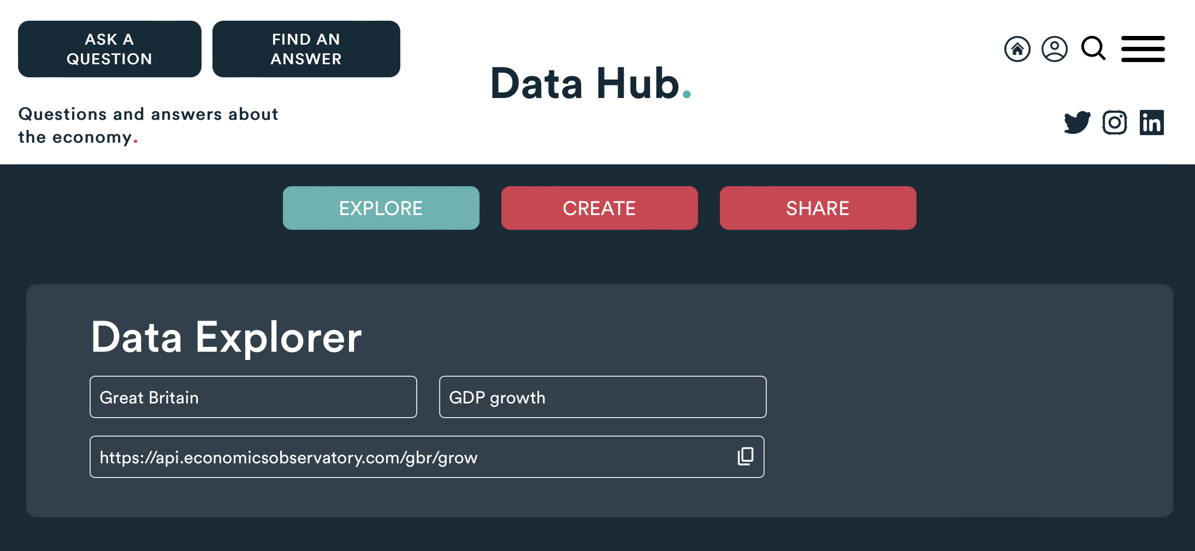
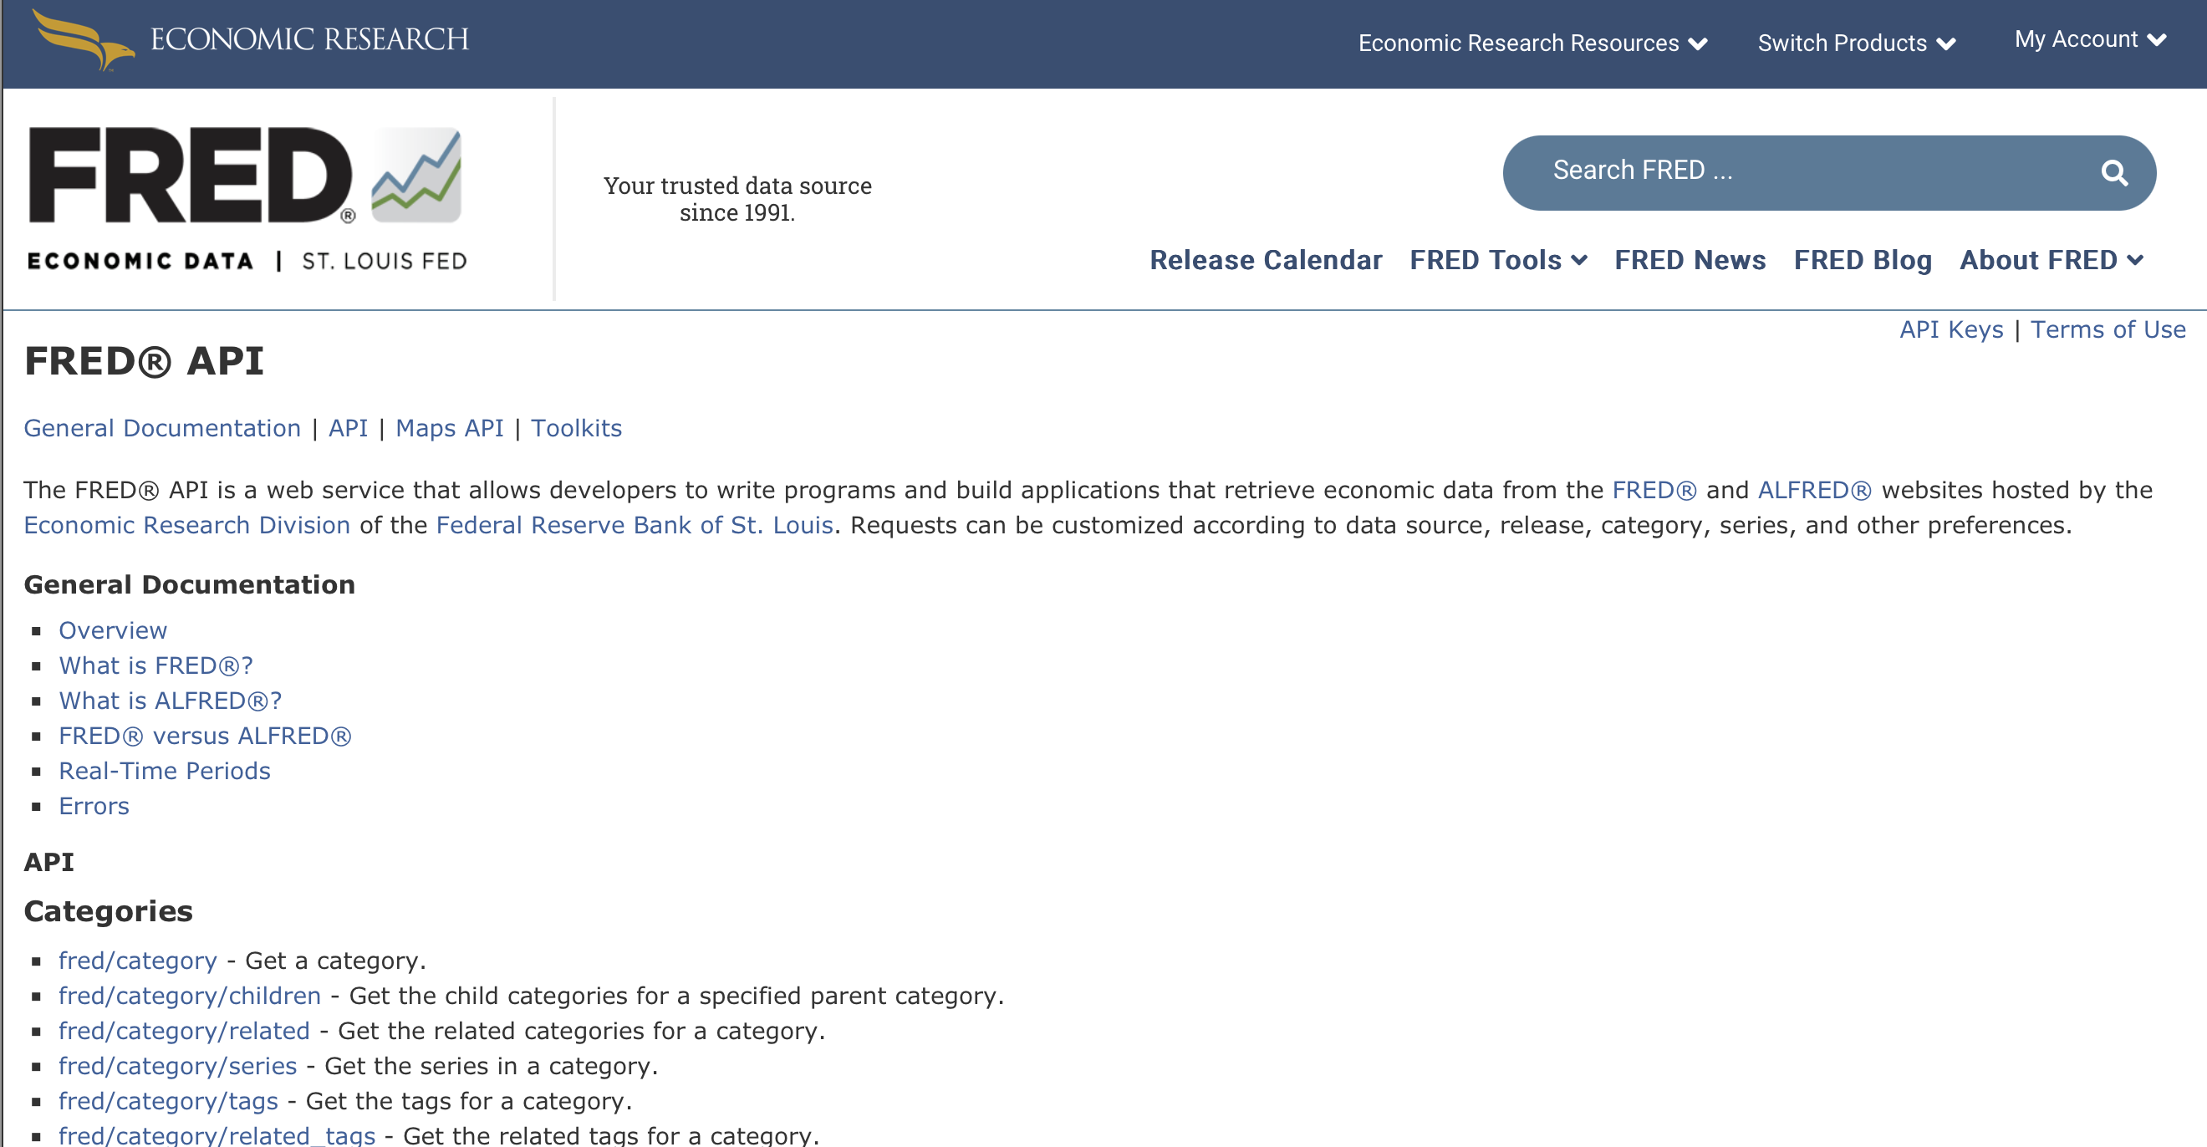
Data.
when we’re lucky:
Structured Files
(e.g. Excel, CSV, JSON)
APIs
(e.g. ONS, ECO, FRED)
But what do we do when the data we want isn’t available?
Notes:
SCRAPING IS AUTOMATED EXTRACTION
At its simplest: reading HTML which browsers use

Slide 4
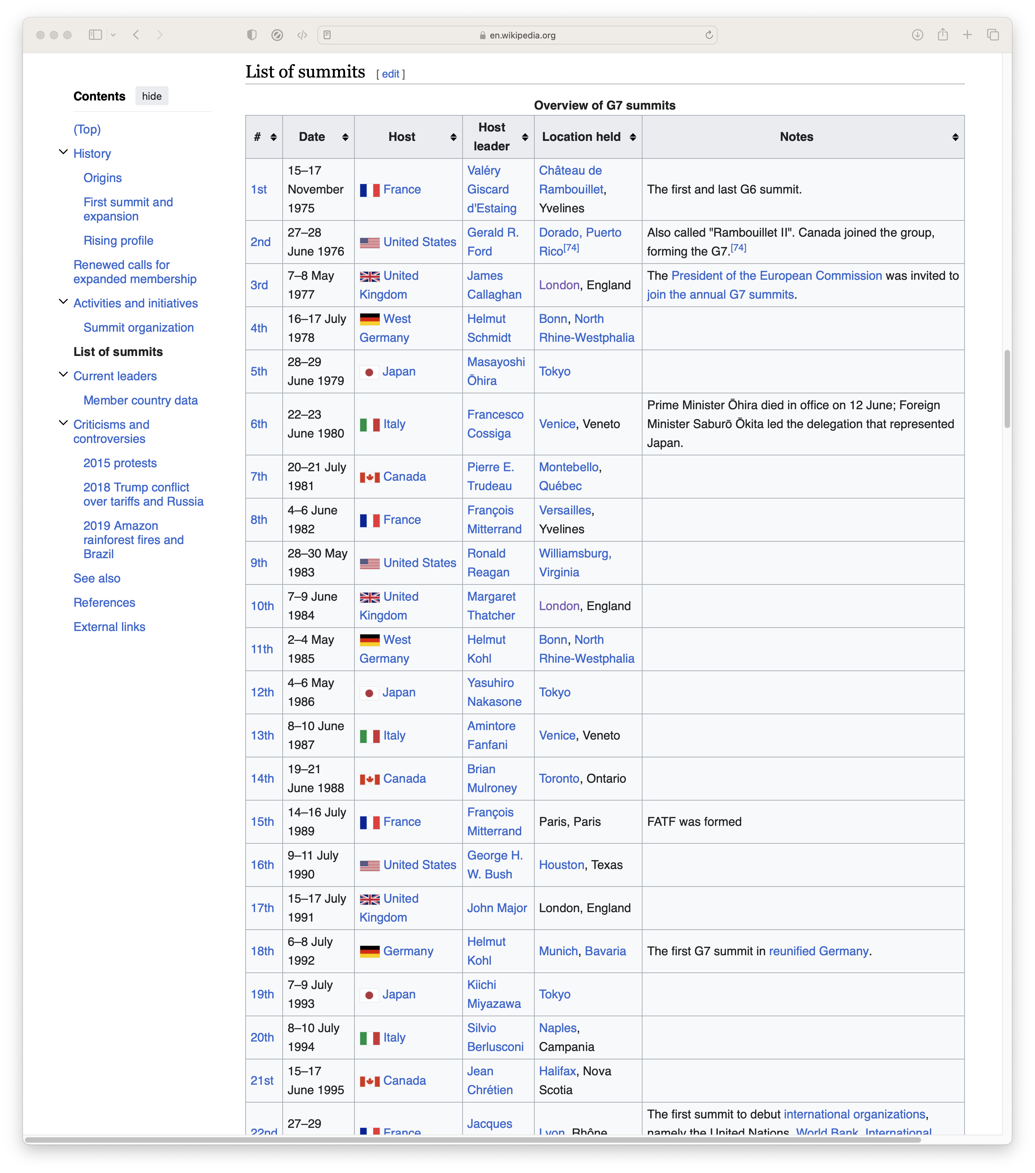
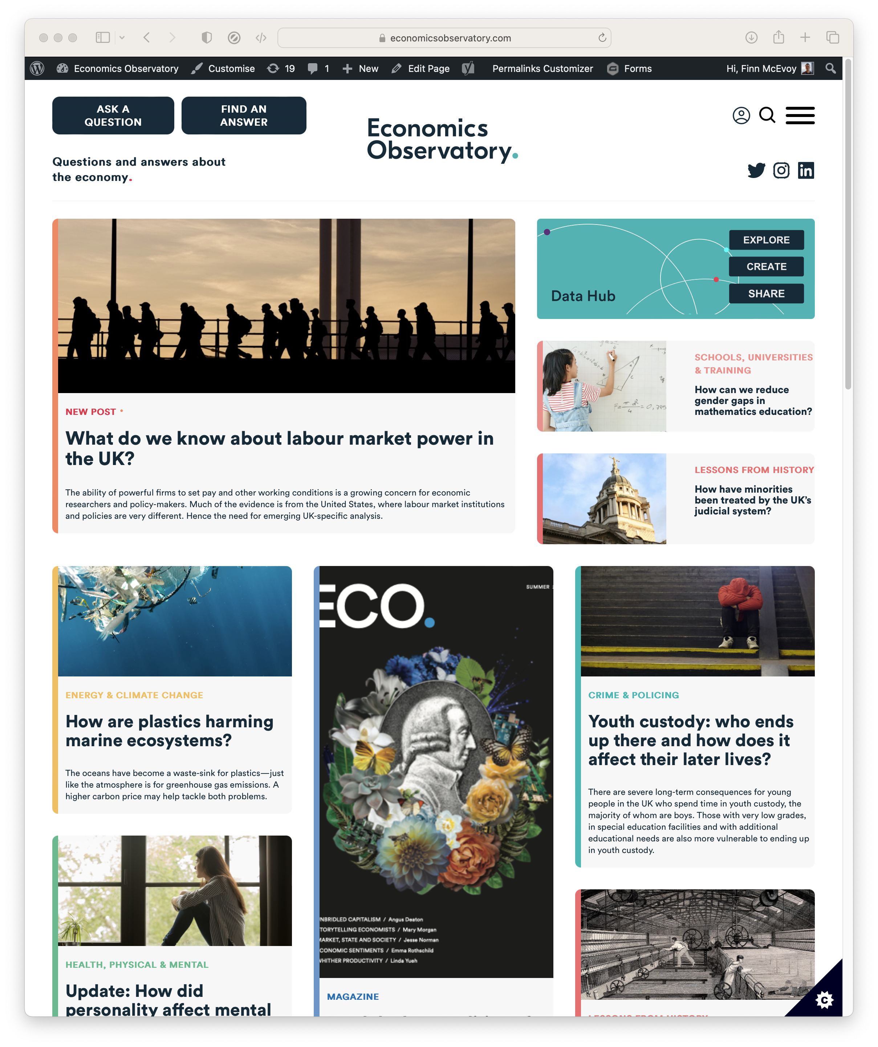
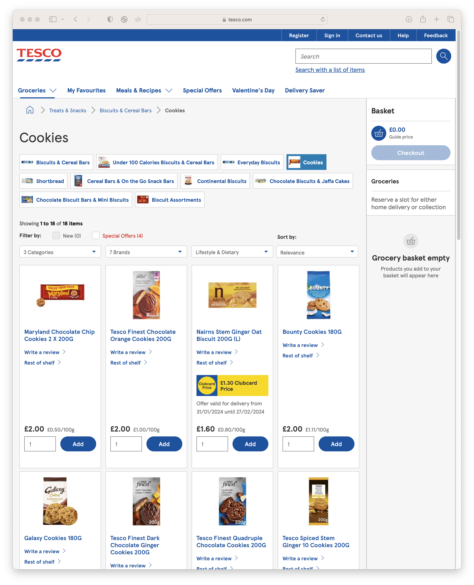
Data.
What if we want
Data from Wikipedia?
News and Media?
Prices from Supermarkets?
Notes:
SCRAPING IS AUTOMATED EXTRACTION
At its simplest: reading HTML which browsers use

Slide 5
Today.
Scraping. Approaches and scraping at the Observatory.
Workshop. Scraping a British retailer.
Q&A.
Notes:
SCRAPING IS AUTOMATED EXTRACTION
At its simplest: reading HTML which browsers use

Slide 6
Scraping.
The automated extraction of data from websites
Parsing HTML to find data
Scraping the HTML source. Easy. Automated.
Scraping HTML pages generated on-the-fly with JavaScript.
Hard. Only zombie browser works, and only in some cases.
Notes:
SCRAPING IS AUTOMATED EXTRACTION
At its simplest: reading HTML which browsers use

Slide 7
Scraping.
The automated extraction of data from websites
Parsing HTML to find data
Scraping the HTML source. Easy. Automated.
Scraping HTML pages generated on-the-fly with JavaScript.
Hard. Only zombie browser works, and only in some cases.
Scraping the HTML source. Easy. Automated.

Slide 8
Parsing HTML.
(Almost) all the data displayed on websites is found in the HTML
We can extract data by searching the HTML
Everything is defined in the HTML, we just have to find it

Slide 9
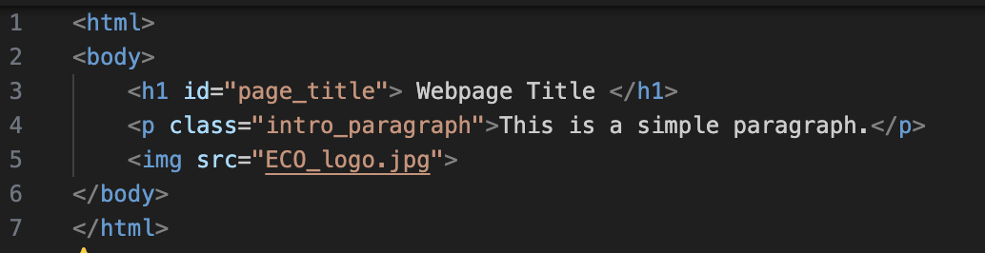
HTML: a primer.
Everything you see on a website is contained in the HTML:
<tags> define elements on the page (<h1>, <p>, <img>)
Tags have attributes (id, class, src) used to define, identify and style them
Notes:
Everything you see on a website is defined w/ the HTML – though often obliquely and via other code

Slide 10

HTML: a primer.
Notes:
Everything you see on a website is defined w/ the HTML – though often obliquely and via other code

Slide 11
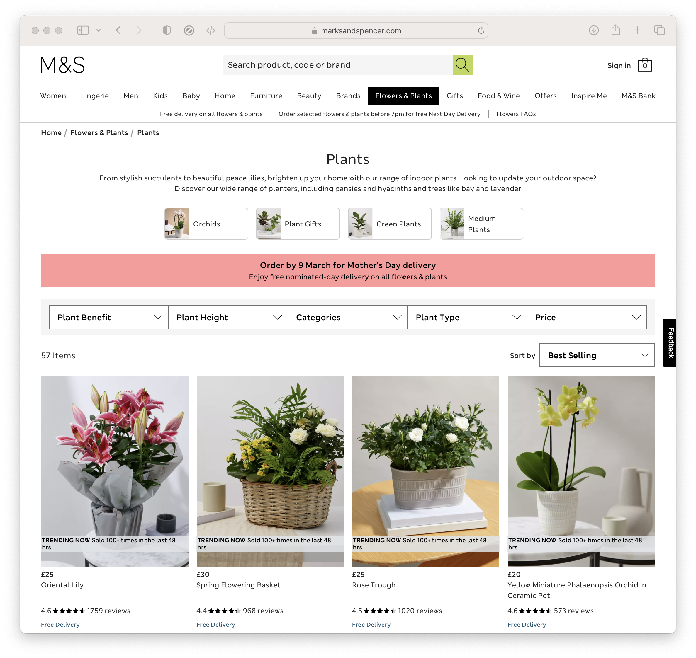
Today.
In this workshop, we’ll try and scrape prices from a British retailer. We will:
Investigate the page structure with Inspect Element
Extract prices with BeautifulSoup
Start to visualise the data
So, why is this useful?
Notes:
Everything you see on a website is defined w/ the HTML – though often obliquely and via other code

Slide 12
Scraping in action.
Scraping at the Economics Observatory:
Prices Research: we scrape 100K prices a day from 7 British supermarkets to research inflation and trade. (Davies and McEvoy, 2024; Davies and Hellings, 2024)
ECO API: we’re scraping national stats agencies to build an international data API
Notes:
Josh and I are part of the Economics Observatory at the SPP

Slide 13
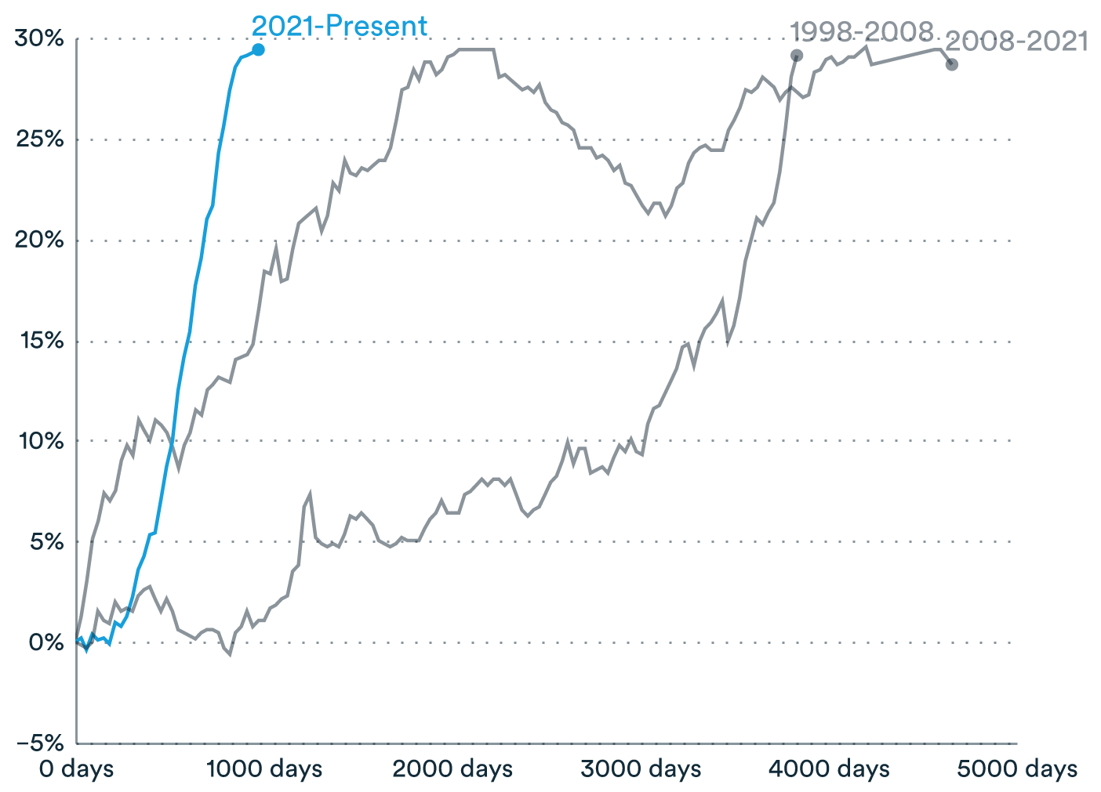
Scraping Prices.
Why?
Between January 2021 and October 2023 (1003 days), food prices increased by 30%.
It took 4658 days (March 2008 – Jan 2021) for food prices to increase by 30% before that.
Notes:
We’re going from supermarket websites to a huge database of prices

Slide 14
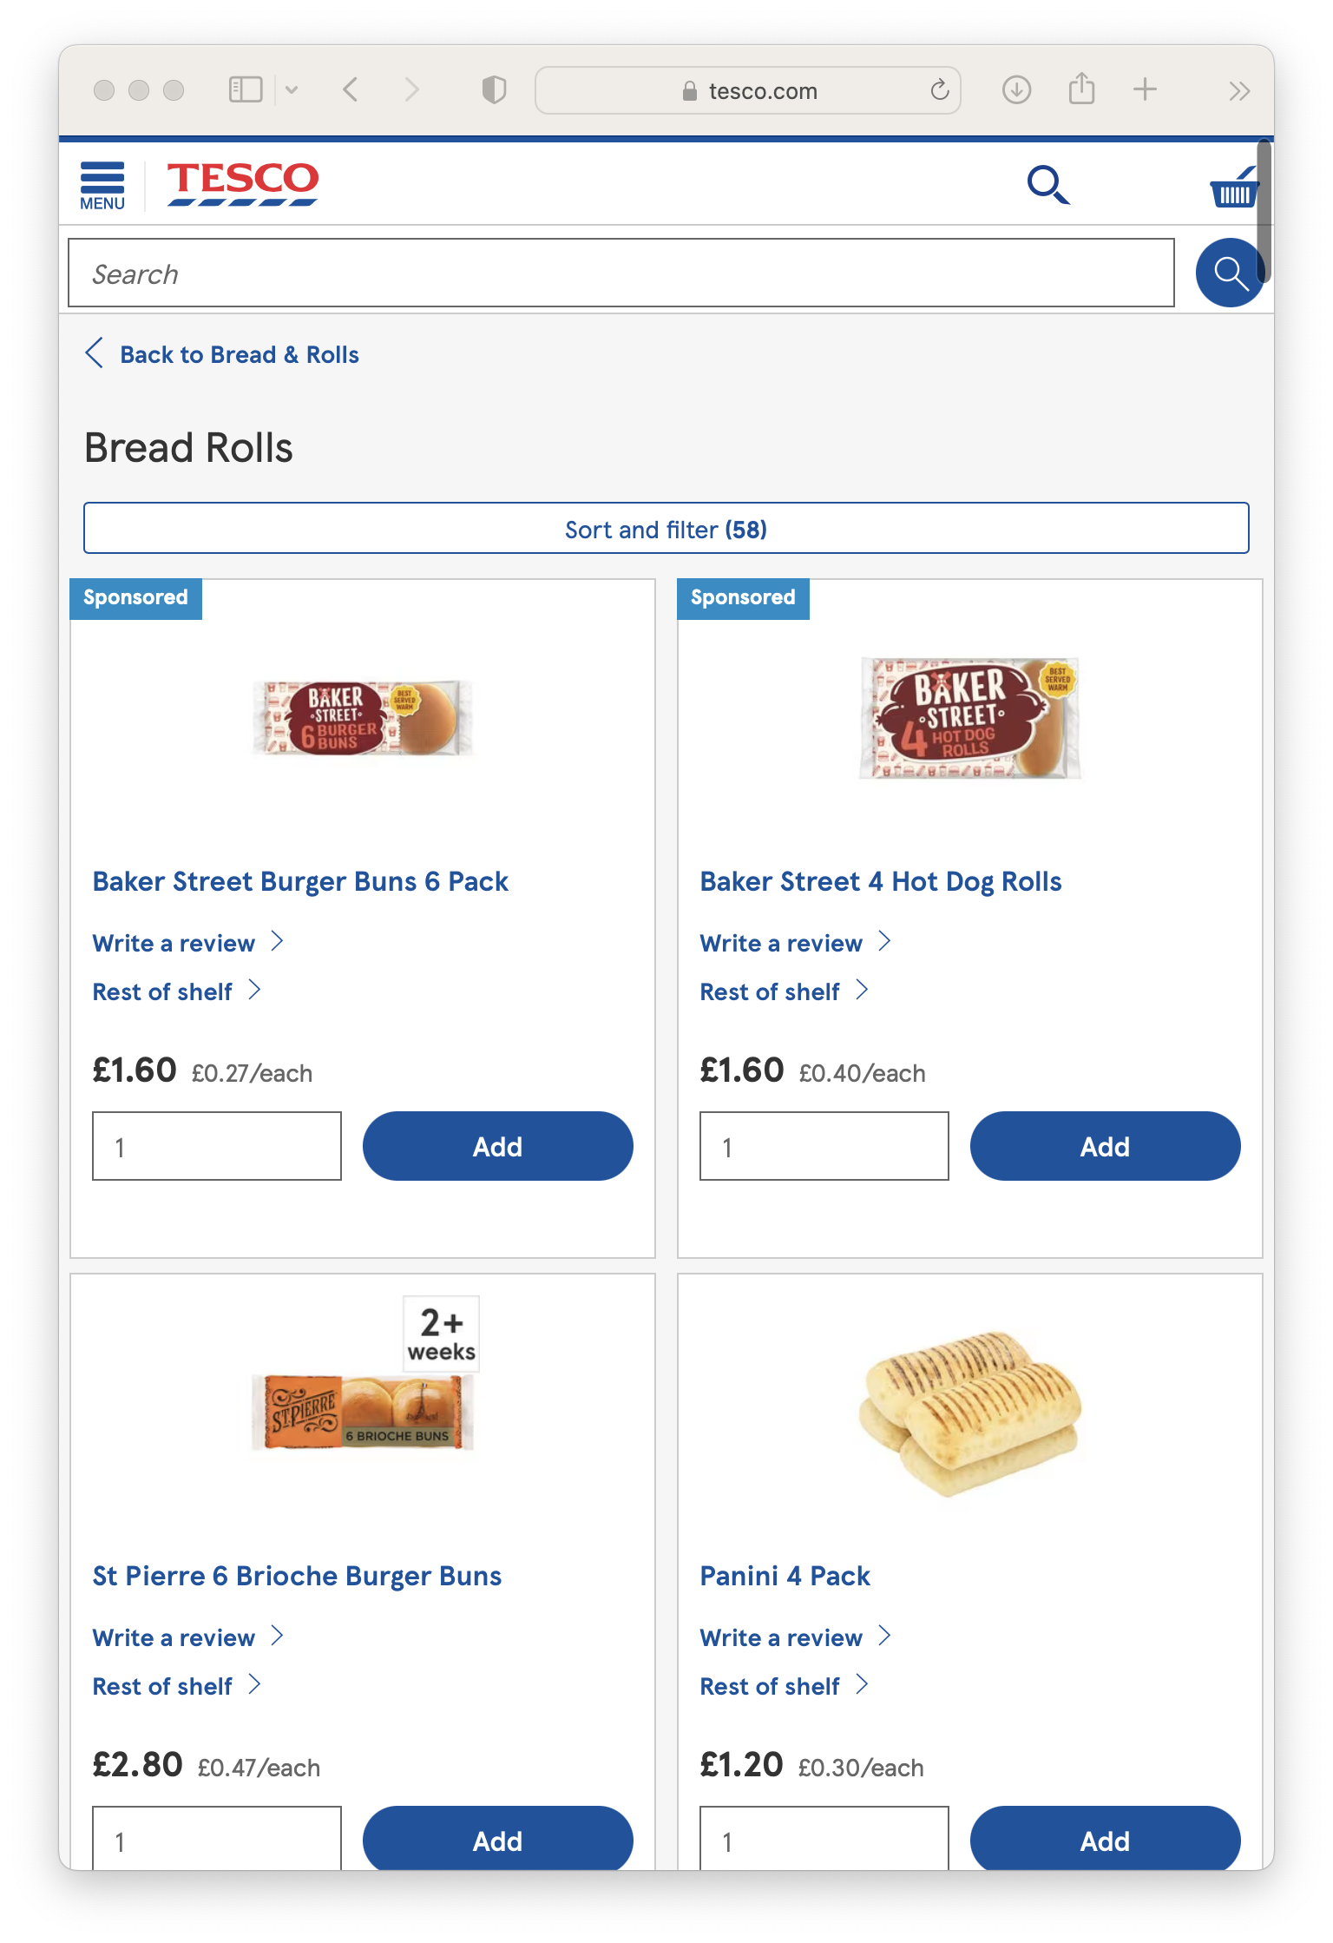
Scraping Prices.
Product Title | Category | Price | Relative price
Baker Street Burger Buns 6 Pack | Bakery, Bread Rolls | £1.50 | £0.27/each
Baker Street 4 Hot Dog Rolls | Bakery, Bread Rolls | £1.60 | £0.40/each
St Pierre 6 Brioche Burger Buns | Bakery, Bread Rolls | £2.80 | £0.47/each
Panini 4 Pack | Bakery, Bread Rolls | £1.20 | £0.30/each
Notes:
We’re going from supermarket websites to a huge database of prices

Slide 15
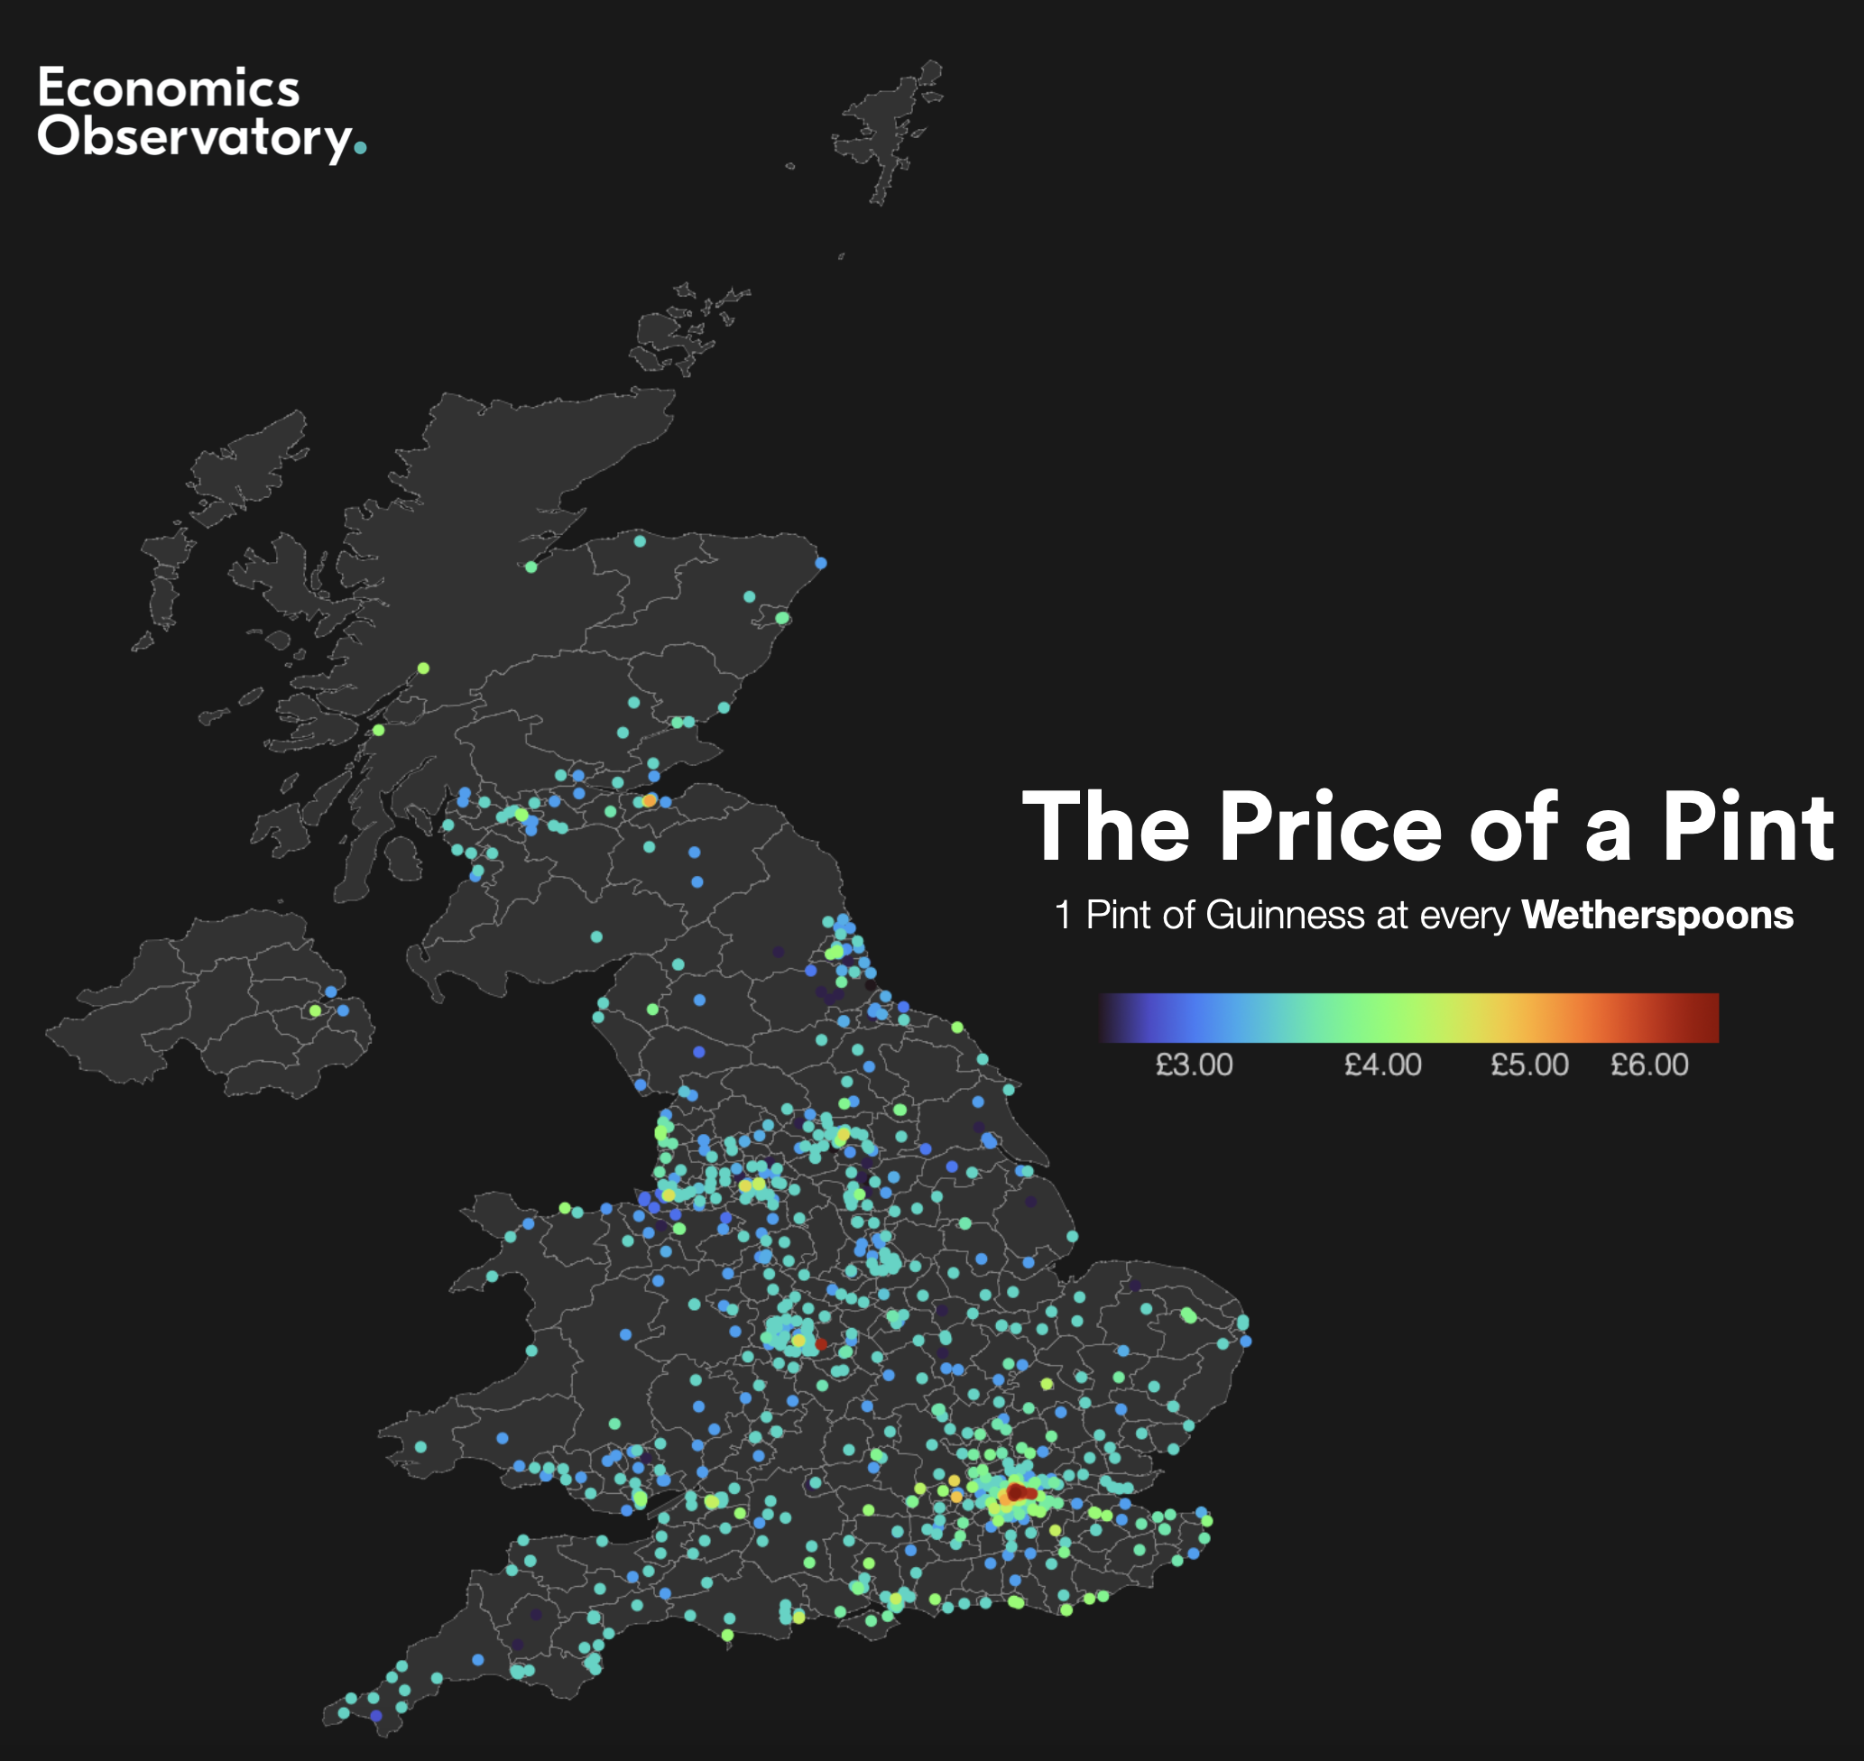
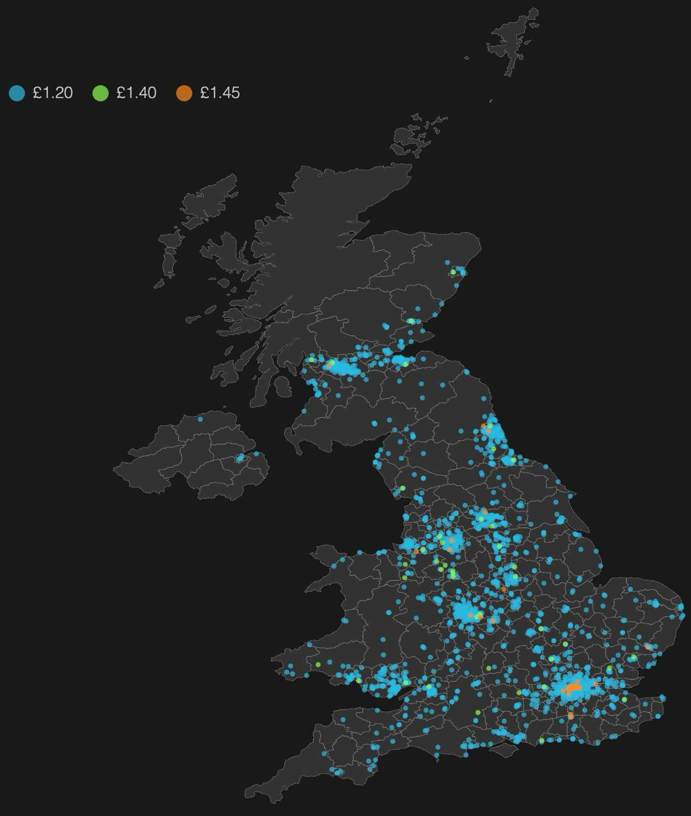


What do these maps show?

Slide 16
What do these maps show?

Slide 17
Guinness, 1 pint, Wetherspoons
Vegan sausage roll, Greggs

Slide 18
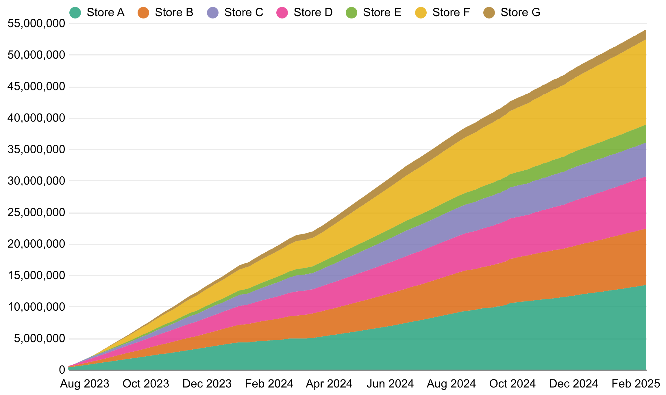
Scraping Prices.
Our sample:
100,000 prices per day
53M prices since July 2023
7 Supermarkets
>80% of UK Grocery Market Share
Notes:
We’re going from supermarket websites to a huge database of prices

Slide 19
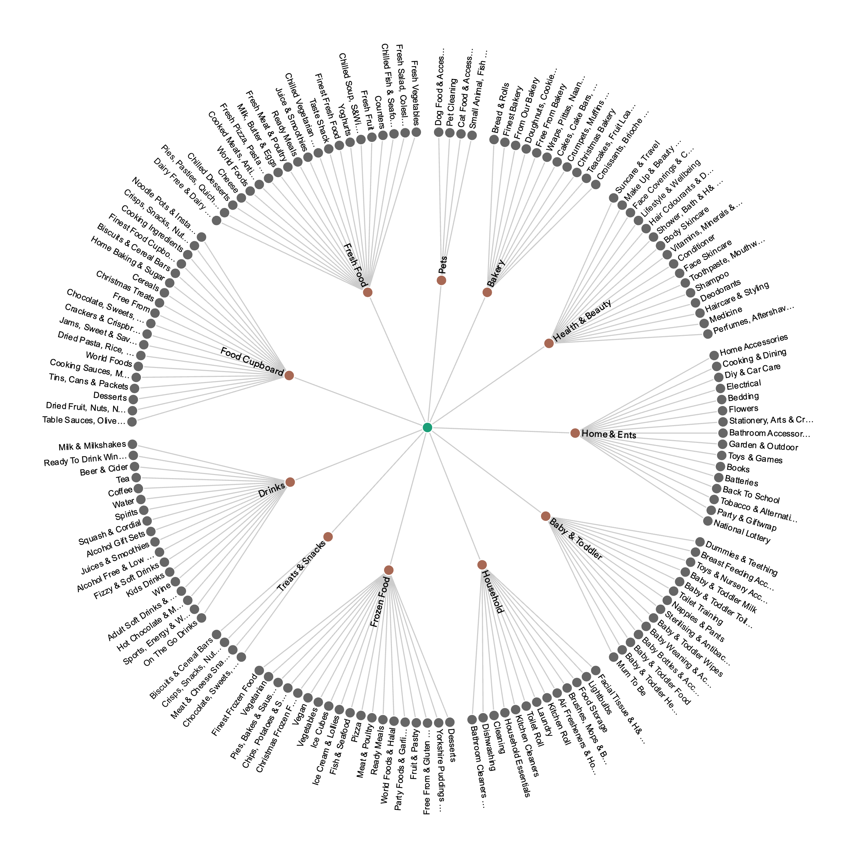
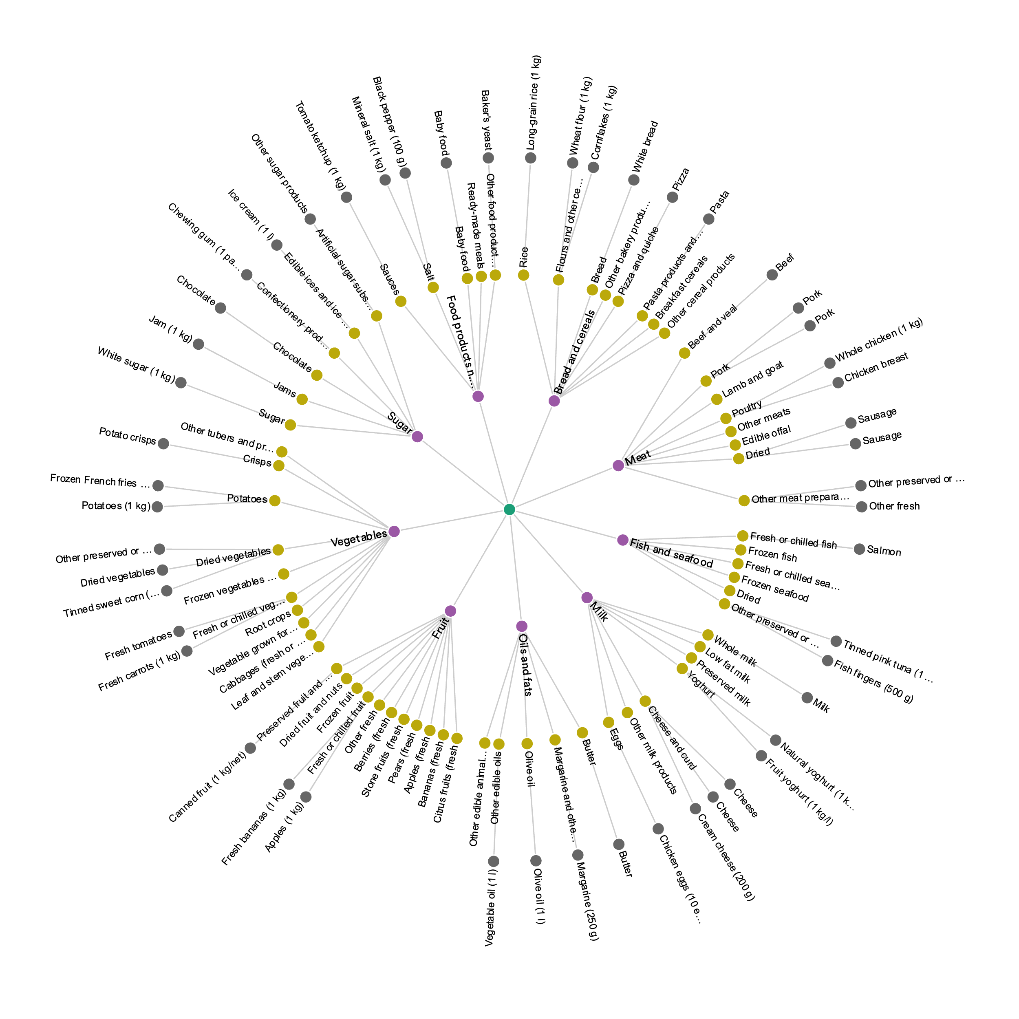
Scraping Prices.
We then classify our products, bridging supermarket and CPI items:
(A Supermarket System)
(The COICOP System)
Notes:
Matching Process:
- Bulk of it is through embeddings (explained on next slide)
But also:
- preprocessing
– Experimental AI Enhancements

Slide 20
Scraping Prices.
We then classify our products, bridging supermarket and CPI items:
Notes:
Matching Process:
- Bulk of it is through embeddings (explained on next slide)
But also:
- preprocessing
– Experimental AI Enhancements

Slide 21
Scraping Prices.
LLM-driven Classification
Notes:
Matching Process:
- Bulk of it is through embeddings (explained on next slide)
But also:
- preprocessing
– Experimental AI Enhancements

Slide 22
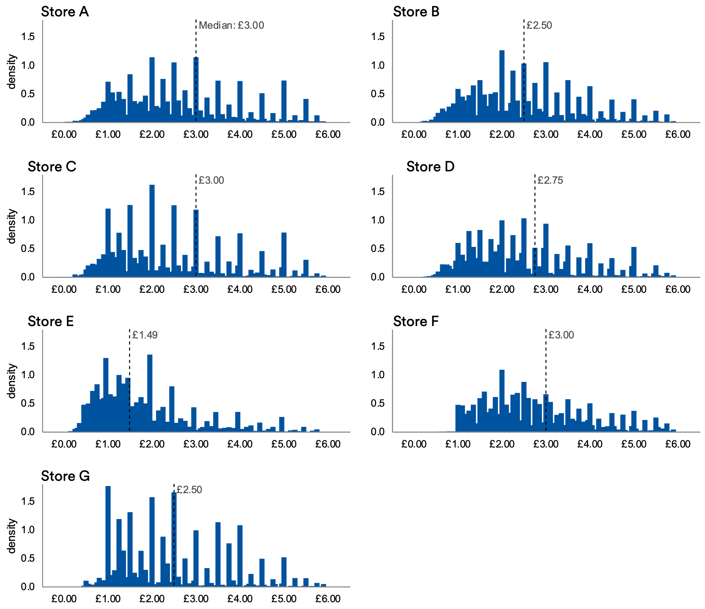
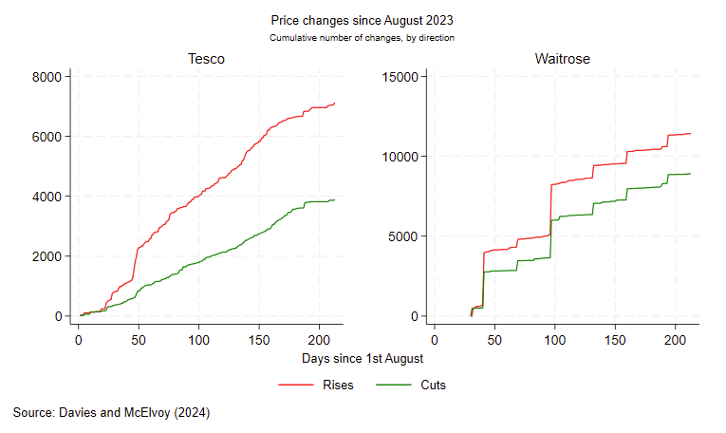
Scraping Prices.
We can investigate the pricing structures and strategies:
Store A
Store B
Notes:
Matching Process:
- Bulk of it is through embeddings (explained on next slide)
But also:
- preprocessing
– Experimental AI Enhancements

Slide 23
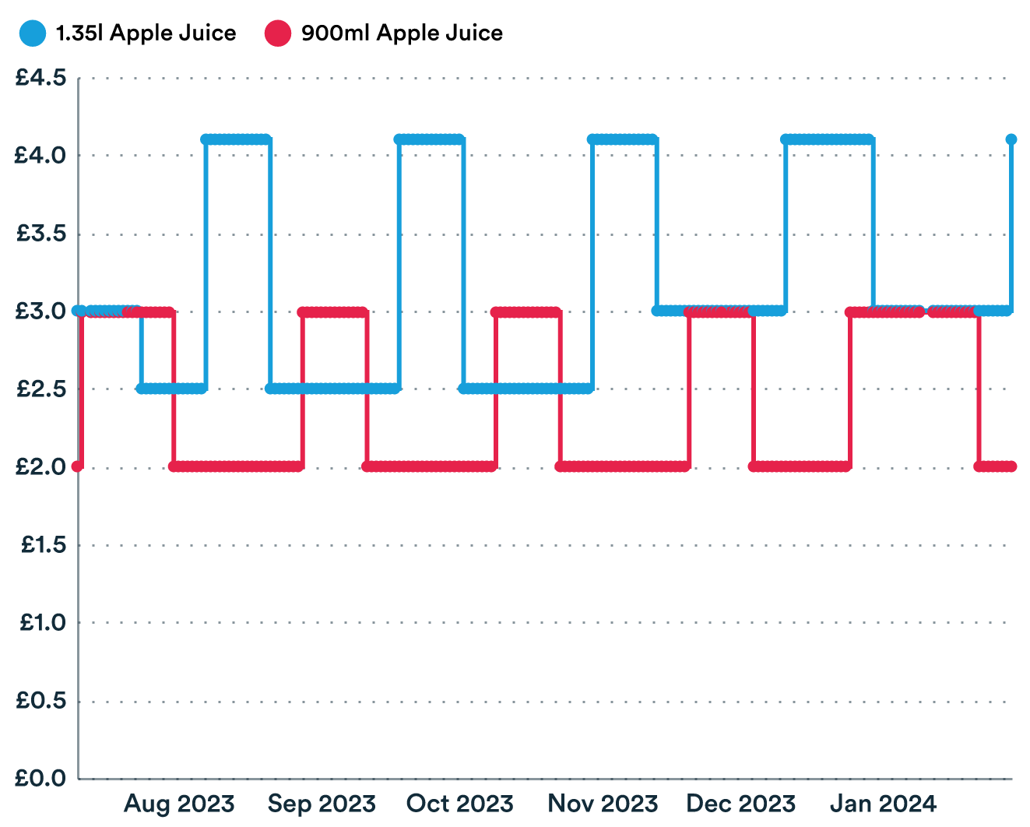
Scraping Prices.
And uncover novel behaviour:
Prop Prices: Supermarkets keeping near duplicates for legal compliance
Shifts towards loyalty pricing
Large adjustment days where many prices change

Slide 24
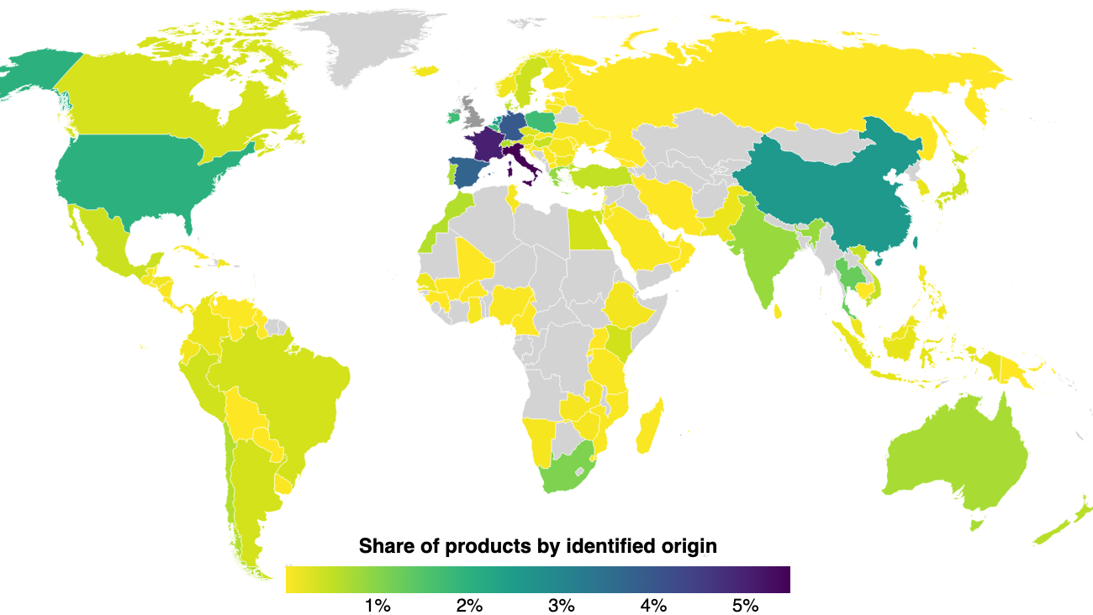
Scraping Prices.
And investigate trade:
Extracting countries of origin from descriptions
Looking at regional delicacies (PDO products)
Calculating source-specific inflation

Slide 25
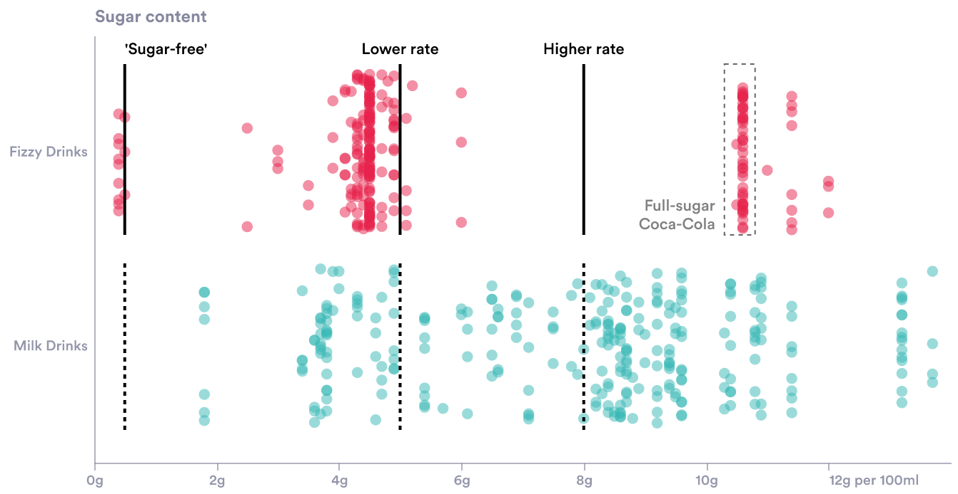
Motivation: policy evaluation
Preparing for changes in the soft drinks industry levy
We’re working with HMRC to evaluate the impact of expected changes in the SDIL.

Slide 26
Code-along.
In this workshop, we’ll try and scrape prices from a British retailer.
Open Scraping.ipynb at
tinyurl.com/2xw9tdus
Notes:
Everything you see on a website is defined w/ the HTML – though often obliquely and via other code

Slide 28
Today.
Today we scraped prices from Marks and Spencers by:
Requesting HTML with the Requests module
Extracting data with BeautifulSoup
Cleaning data with Pandas
Scraping most modern websites is more complicated!

Slide 29
It gets more complicated...
Most modern websites are more difficult:
Some require interaction (e.g. infinite scroll w/ JavaScript)
Some load data with JavaScript on the page
Some verify the browser (e.g. Captchas and verification code)
This means you can’t always rely on Requests only.

Slide 30
Where to go from here.
If you want to try more scraping:
Selenium lets you control a real browser – much harder to block
Try automating and controlling proxies – avoid requests from 1 ip.
Examine closely websites’ structure. How do they request data?

